Slide 1



UNIT 2
Lesson 5 Achievements
Part 3

Slide 2
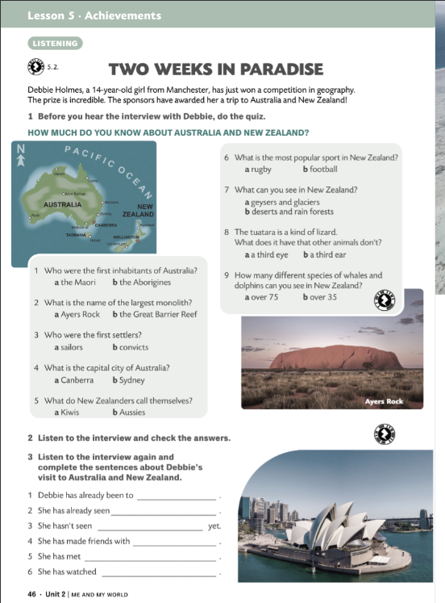
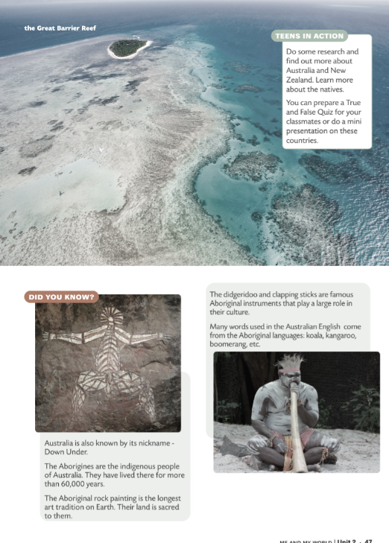
BRAINSTORMING
AUSTRALIA

Slide 3
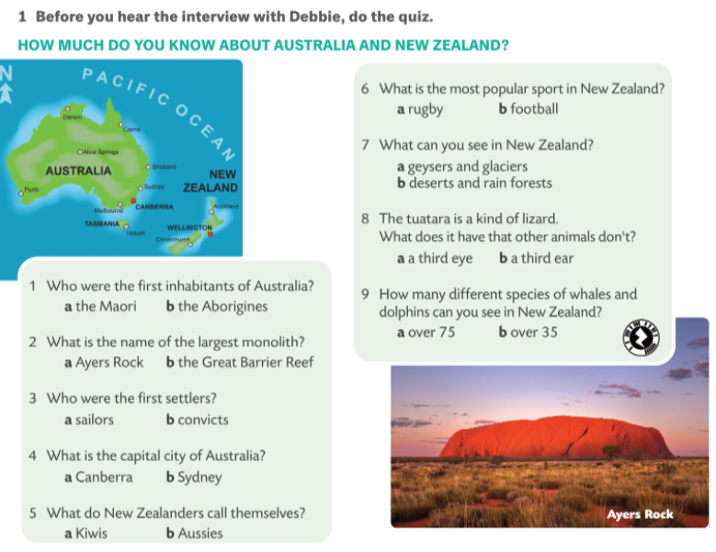


Slide 4
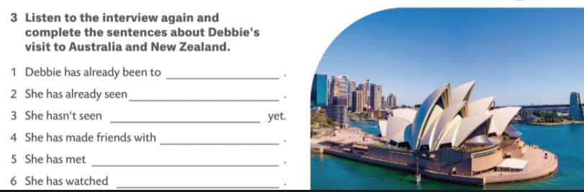
Sydney, Canberra and Melbourne.
Ayers Rock.
the Great Barrier Reef and a kiwi.
with a girl from Wellington.
an old Aborigine, a didgeridoo player.
a rugby match.
Give additional information about the places, people, animals, or instruments mentioned in the interview.

Slide 5
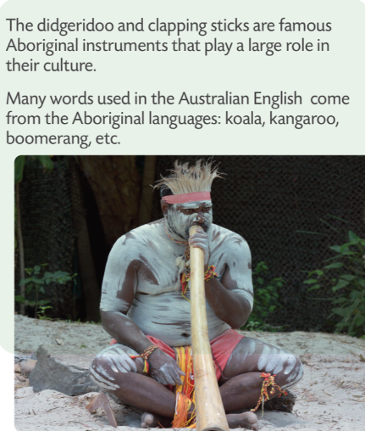
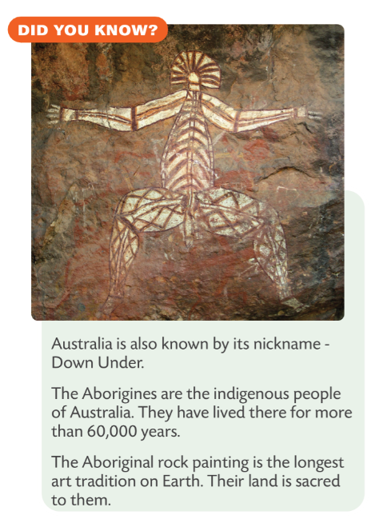

Try to explain why the title is Two weeks in paradise.
Read the Did you know information and report on that.

Slide 6
